Slide 1
Hotel Booking Analysis Project
Using Python
By Jignesh Jadvani

Slide 2
BUSINESS PROBLEM
◾ In recent years, City Hotel and Resort Hotel have seen high cancellation rates. Each hotel is now dealing with a number of issues as a result, including fewer revenues and less than ideal hotel room use. Consequently, lowering cancellation rates is both hotels’ primary goal in order to increase their efficiency in generating revenue and for us to offer thorough business advice to address this problem.
The analysis of hotel booking cancellations as well as other factors that have no bearing on their business and yearly revenue generation are the main topics of this report.

Slide 3
ASSUMPTIONS
◾ No unusual occurrences between 2015 and 2017 will have a substantial impact on the data used
◾ The information is still current and can be used to analyse a hotel’s possible plans in an efficient manner.
◾ There are no unanticipated negatives to the hotel employing any advised technique.
◾ The hotels are not currently using any if the suggested solutions.
◾ The biggest factor affecting the effectiveness of earnings income is booking cancellations
◾ Cancellations result in vacant rooms for the booked length of time.
◾ Clients make hotel reservations the same year they make cancellations.

Slide 4
RESEARCH QUESTIONS
◾ What are the variables that affect hotel reservation cancellations?
◾ How can we make hotel reservations cancellations better?
◾ How will hotels be assisted in making pricing and promotional decisions?

Slide 5
HYPOTHESIS
◾ More cancellations occur when prices are higher.
◾ When there is a longer waiting list, customers tend to cancel more frequently.
◾ The majority of clients are coming from offline travel agents to make their reservations.

Slide 6
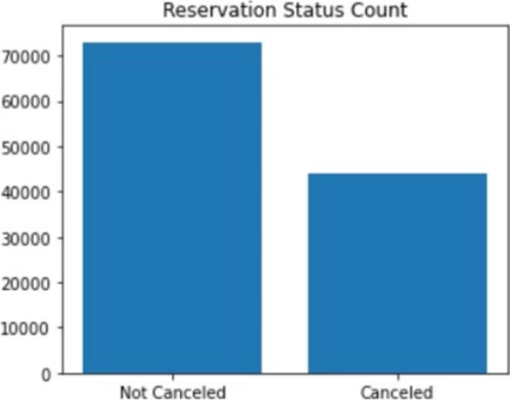
ANALYSIS AND FINDINGS - 1
◾ The accompanying bar graph shows the percentage of reservations that are cancelled and those that are not. It is obvious that there are still a significant number if reservations that have nit been cancelled. There are still 37% of clients who cancelled their reservations, which has a significant impact on the hotels’ earnings.

Slide 7
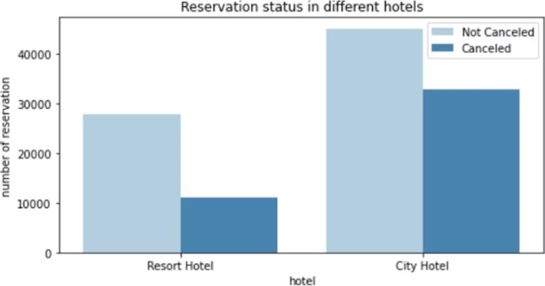
ANALYSIS AND FINDINGS - 2
◾ In comparison to resort hotels, city hotels have more bookings. It is possible that resorts hotels are more expensive than those in cities.

Slide 8
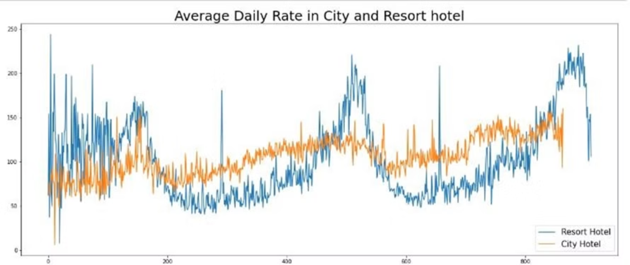
ANALYSIS AND FINDINGS - 3
◾ The line graph shows that on certain days, the average daily rate for a city hotel is less than that of a resort hotel, and on other days, it is even less, It goes without saying that weekends and holidays may see a rise in resort hotel rates.

Slide 9
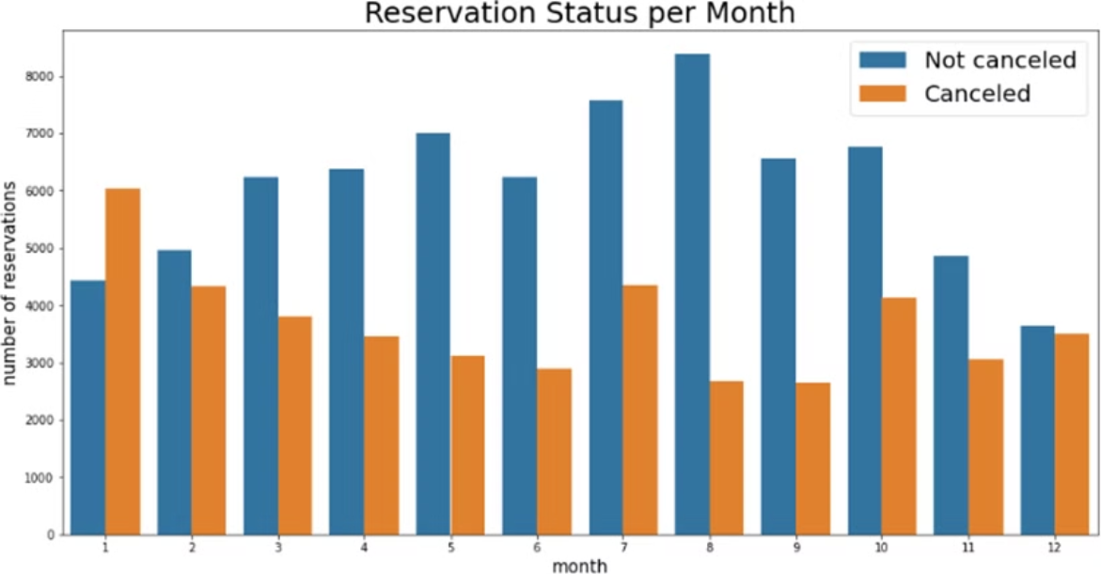
ANALYSIS AND FINDINGS - 4
◾ We have developed the grouped bar graph to analyse the months with the highest and lowest reservation levels according to reservation status. As can be seen, both the number of confirmed reservations and the number of cancelled reservations are largest in the month of August, whereas January is the month with the most cancelled reservations.

Slide 10
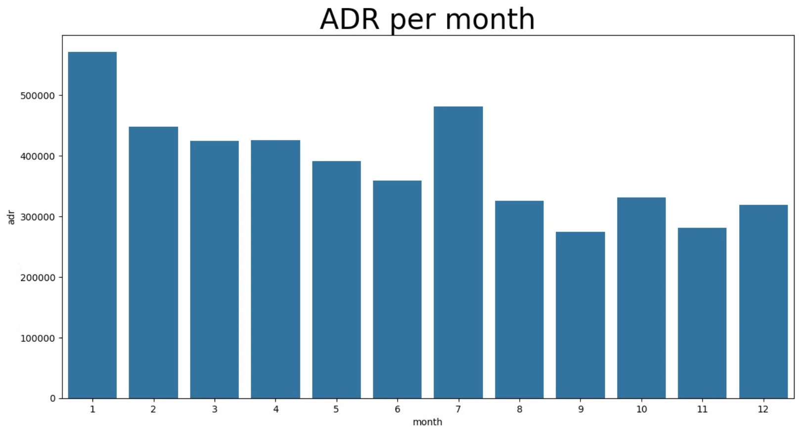
ANALYSIS AND FINDINGS - 5
◾ The bar graph demonstrates that cancellations are most common when prices are greatest and are least common when they are lowest.Therefore, the cost of the accommodation is solely responsible for the cancellation.

Slide 11
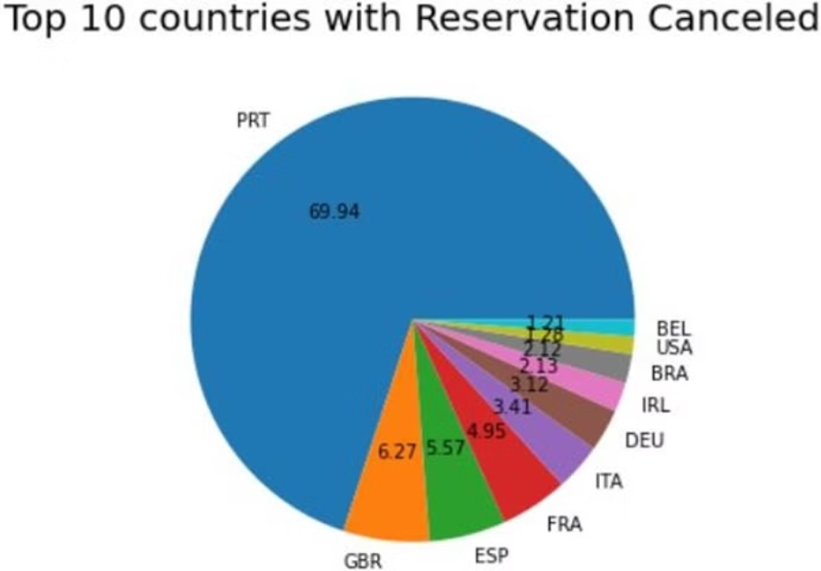
ANALYSIS AND FINDINGS - 6
◾ The pie chart shows which country has the highest reservations cancelled.The top country is Portugal with the highest number of cancellations.

Slide 12
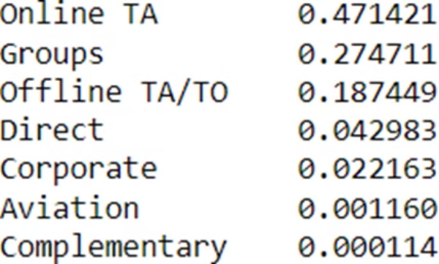
ANALYSIS AND FINDINGS - 7
◾ The table shows the areas from where guests are visiting the hotels and making reservations, whether it is coming from Direct or Groups, Online or Offline Travel Agencies.
◾ We can see around 47% of clients come from online travel agencies, whereas 27% come from groups. Only 4% of clients book hotels directly by visiting them and making reservations.

Slide 13
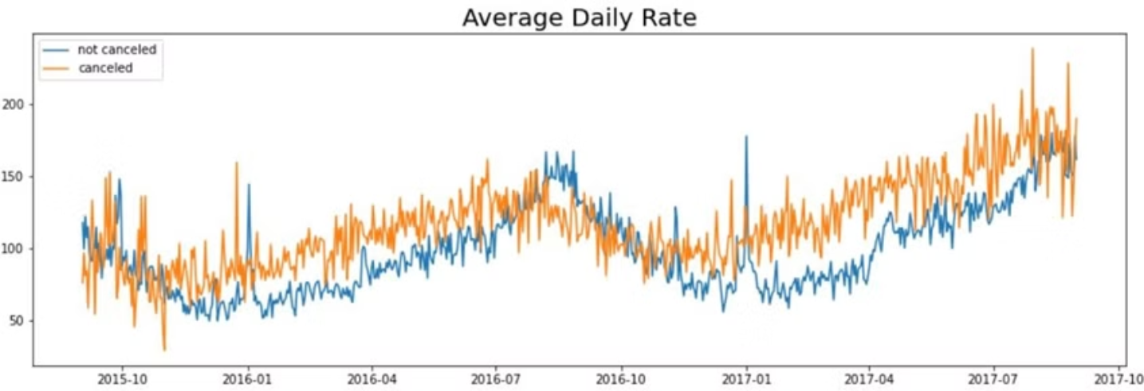
ANALYSIS AND FINDINGS - 8
◾ As seen in the graph, reservations are cancelled when the average daily rate is higher that when it is not cancelled. It clearly proves all the above analysis, that the higher price leads to higher cancellations

Slide 14
SUGGESTIONS
◾ Cancellation rates rise as the price dates. In order to prevent cancellations of reservations, hotels could work on their pricing strategies and try to lower the rates for specific hotels based on locations.They can also provide some discounts to the consumers.
◾ As the ratio of the cancellations and not cancellation of the resort hotels is higher in the resort hotel than the
city hotels. So the hotels should provide a reasonable discount on the room prices on weekends or on holidays.
◾ In the month of January, hotels can start campaigns or marketing with a reasonable amount to increase the revenue as the cancellation is the highest in this month.
◾ They can also increase the quality of the hotels and their services mainly in Portugal to reduce the cancellation rate.

Slide 15
THANK YOU
Thank you for your time and consideration. We appreciate the opportunity to present our analysis and insights. We believe our recommendations will help you achieve your business goals.
We are confident that by implementing these strategies, you can optimize your hotel operations and increase profitability.

